Slide 1
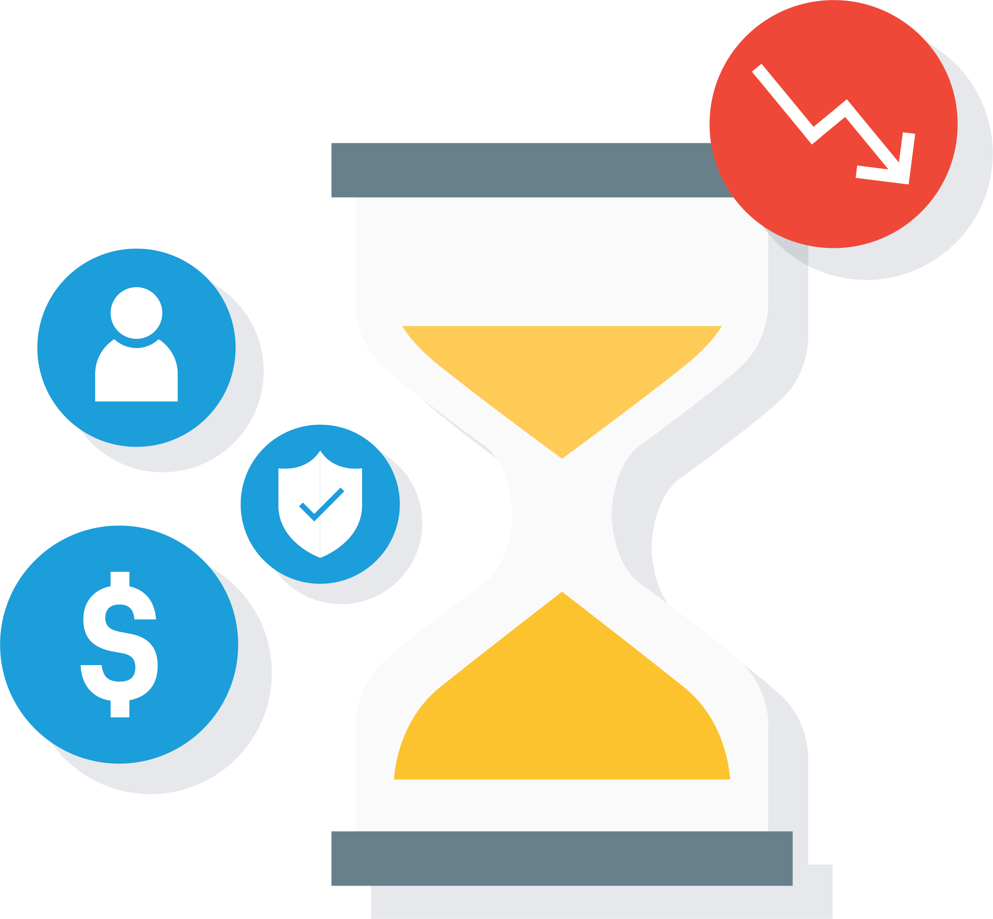
The Cost of
Downtime

Slide 2
Unplanned downtime may be an IT function, but it is a business concern.
Downtime is not a question of if, but when.
24% of companies said they experienced a full data disaster ⁽¹⁾
44% of small businesses have been the victim of a cyber attack ⁽²⁾
Average midsize companies have 16 to 20 hours of network, system, or application downtime per year ⁽³⁾
Forrester Research Study
National Small Business Association
Gartner Group

Slide 3
Is it worth the risk, to be unprepared?
Many compliance regulations, like HIPAA, require a data backup and data recovery plan ⁽¹⁾
70% of small business that experience a major data loss go out of business within a year ⁽²⁾
Department of Health & Human Services: HIPAA Security Rules - Security Standards for the Small Provider: [link]
PricewaterhouseCooper

Slide 4

Data loss means downtime, and downtime will impact your bottom line:
People and Systems Costs
Lost sales revenue
Lost employee productivity
Missed deadlines that result in employee overtime
No communication; no email
All internal business processes will cease - billing, HR, intranet, etc.
Physical Damage Costs
Cost to restore IT systems
Materials lost/disposal and cleanup costs
Reputation & Compliance Costs
The financial impact of customer dissatisfaction
Contract penalties
Compliance violations, if applicable
IT and employee recovery costs

Slide 5

Protecting Your Data is Protecting Your Business
Do you have business insurance?
For your building?
For your employees?
Why not your business data?
You may end up using your backup and disaster recovery solution before you’ll use your insurance.

Slide 6
Prepare Now, Save Later
“The average small business can expect to lose $100,000 worth of revenue in unplanned downtime every year” ⁽¹⁾
Downtime cost = $8,600 per hour
Average downtime lasts 7 hours
Lost productivity of employees = ??
Aberdeen Essentials

Slide 7
Recovery Time Objective (RTO)
No two businesses are the same. Do you know how long can your business be down without it affecting your bottom line?
Seconds
Minutes
Hours
Days
Never

Slide 8
The Good News
You can keep your business running with:
A business continuity solution, tailored to your business needs
An IT service provider who manages the entire process

Slide 9

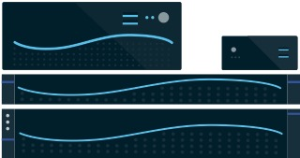
Business Continuity Built for Businesses of Every Size
Servers
Cloud
PCs
SIRIS
SaaS protection
Cloud Continuity for PCs

Slide 10
An IT service provider who manages the entire process

